Slide 1


GBME Probability and Statistics | Fall 2018
Lecture 08 | 100818
Lecture 08
Collecting data, Probability I
CHOONG-WAN WOO | COCOAN lab | http://cocoanlab.github.io

Slide 2
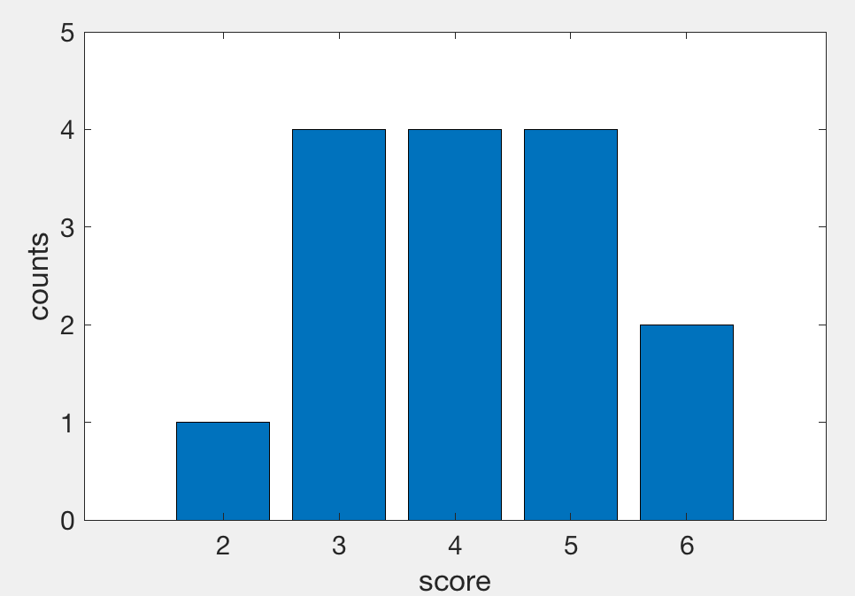
Lecture 08 | 100818
Quiz 1 stats
Mean = 4.13
Standard deviation = 1.19
CHOONG-WAN WOO | COCOAN lab | http://cocoanlab.github.io

Slide 3
Lecture 08 | 100818
Review: Key Points
Chapter 9 and 10: Regression wisdom, re-expressing data
Bends, subgroups, outliers
Cautious about extrapolation, causation, lurking variables, summary stats
Tukey’s ladder
Chapter 11 and 12: Randomness, Sampling
Population parameters vs. sample statistics
Sampling methods:
Simple sampling, stratified sampling, cluster sampling, multistage sampling, systematic sampling
Common mistakes in sampling…
CHOONG-WAN WOO | COCOAN lab | http://cocoanlab.github.io

Slide 4
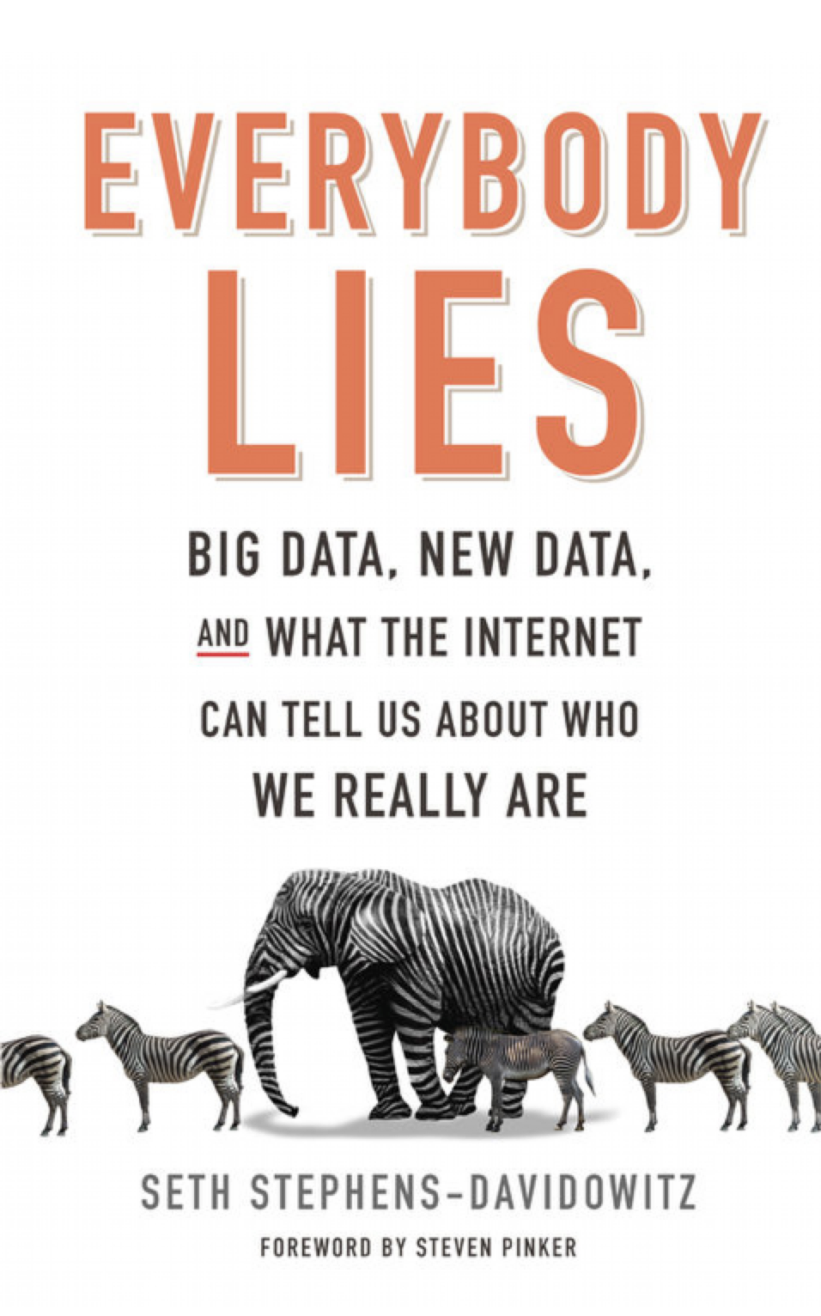
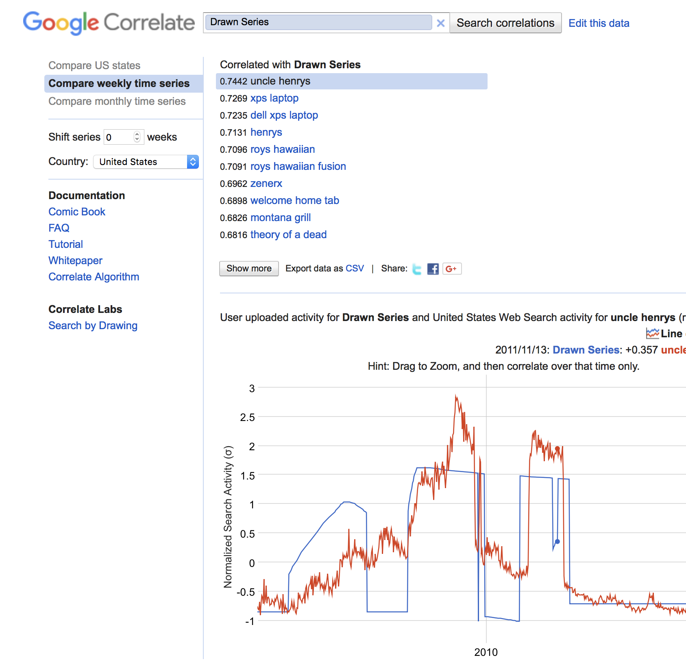
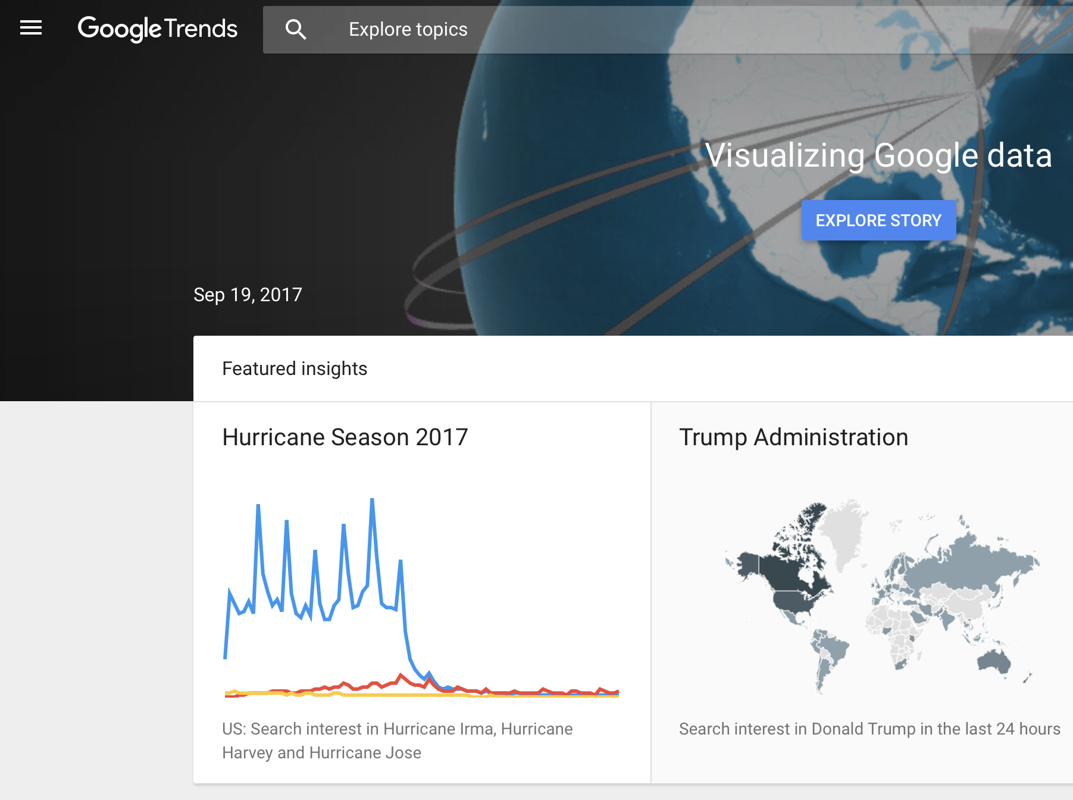
Lecture 08 | 100818
Observational Studies
Researchers do not assign choices, they simply observe them.
An extreme case: https://www.google.com/trends/correlate/draw?p=us
Also Google trends: https://trends.google.com/trends/
CHOONG-WAN WOO | COCOAN lab | http://cocoanlab.github.io

Slide 5
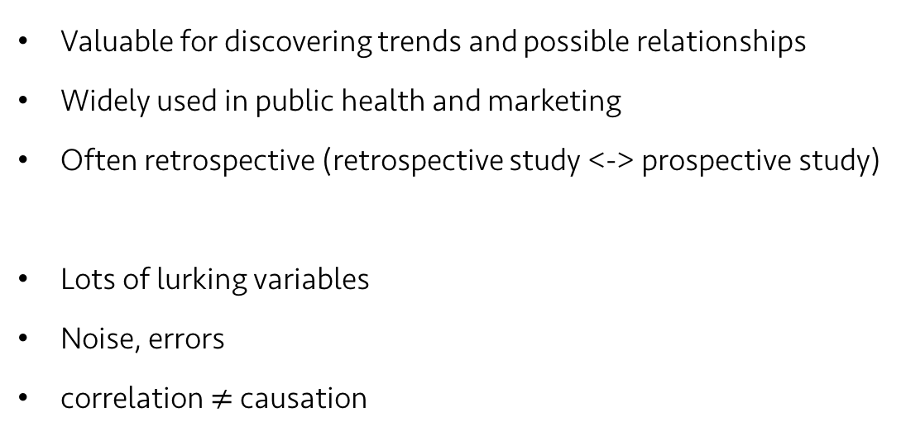
Lecture 08 | 100818
Observational Studies
Valuable for discovering trends and possible relationships
Widely used in public health and marketing
Often retrospective (retrospective study <-> prospective study)
Lots of lurking variables
Noise, errors
correlation $≠$ causation
https://twitter.com/tomfishburne/status/455486271339511808
CHOONG-WAN WOO | COCOAN lab | http://cocoanlab.github.io

Slide 6
Lecture 08 | 100818
Randomized, Comparative Experiments
Experiments require:
Random assignment of subjects to treatments
Manipulate explanatory variables (or factors)
Measure response variables
Four principles of experimental design
Control
Randomize
Replicate
Block
CHOONG-WAN WOO | COCOAN lab | http://cocoanlab.github.io

Slide 7
Lecture 08 | 100818
Experimental design: Control
Control sources of variation other than the factors we’re manipulating
Making conditions as similar as possible for all treatment groups
To reduce the variability of the responses
Bad for generalizability?
Consideration: generalizability and ecological validity
CHOONG-WAN WOO | COCOAN lab | http://cocoanlab.github.io

Slide 8
Lecture 08 | 100818
Experimental design: Randomize
To equalize the effects of unknown or uncontrollable sources of variation
Not eliminating the effects of these sources, but distributing them equally across treatment levels
Protect against factors we might be missing
“Control what you can, and randomize the rest”
CHOONG-WAN WOO | COCOAN lab | http://cocoanlab.github.io

Slide 9
Lecture 08 | 100818
Experimental design: Replicate
Subject-level replication
Repeat treatments to a number of subjects
The outcome of an experiment on a single subject is an anecdote (not data)
Study-level replication
The entire experiment is repeated on a different population of experimental units.
Within-subject level replication
Repeated measures
Reliability
Increase signal-to-noise ratio
CHOONG-WAN WOO | COCOAN lab | http://cocoanlab.github.io

Slide 10
Lecture 08 | 100818
Experimental design: Block
There are things that we are not studying, but we can’t control (e.g., male, female).
We can group similar individuals together (block), and randomize within each of these blocks.
This is a compromise between randomization and control, and this is not required, different than other three, Control, Randomize, Replicate.
This is an idea similar to stratified random sampling.
This design is called “Randomized block design”
CHOONG-WAN WOO | COCOAN lab | http://cocoanlab.github.io

Slide 11
Lecture 08 | 100818
Blinding
Humans are susceptible to errors in judgement (e.g., preference in cola tasting)
Blinding the participants to the treatment could prevent potential biases.
Experimenters can subconsciously provide contextual cues related to treatment.
Two classes of individuals who can affect the outcome of the experiment:
Those who could influence the results (e.g., subjects, treatment administrators, technicians, etc.)
Those who evaluate the results (e.g., judges, treating physicians, etc.)
Single-blind: either one of these classes are blinded
Double-blind: both classes are blinded
CHOONG-WAN WOO | COCOAN lab | http://cocoanlab.github.io

Slide 12
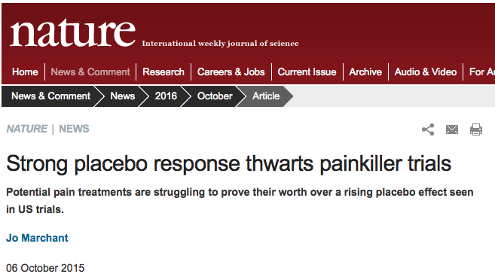
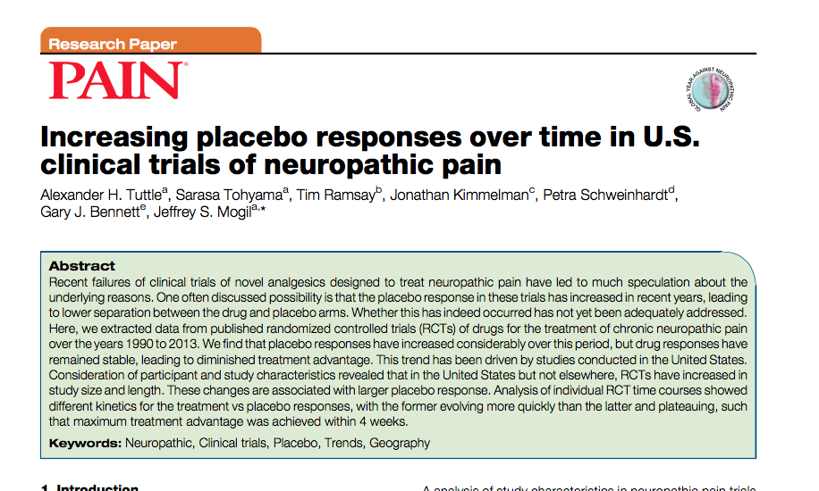
Lecture 08 | 100818
Placebos
Simply applying any treatment can cause an improvement.
Placebo: “fake” treatment that looks just like the real treatment
Placebo effects tells us
The importance of effective blinding
The importance of comparing treatments with a proper control (e.g., active control)
CHOONG-WAN WOO | COCOAN lab | http://cocoanlab.github.io

Slide 13
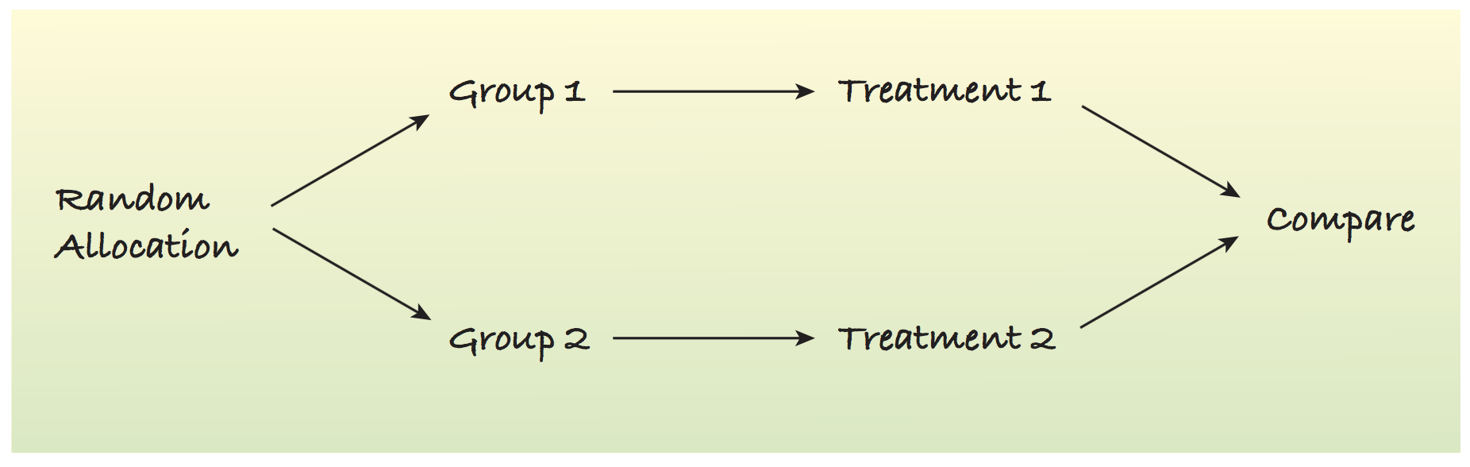
Lecture 08 | 100818
Best experiments:
Randomized
Comparative
Double-blind
Placebo-controlled
Treatment
Double-blind
Placebo
CHOONG-WAN WOO | COCOAN lab | http://cocoanlab.github.io

Slide 14
Lecture 08 | 100818
Confounding
Two factors are confounded: when the levels of one factor are associated with the level of another factor.
No way to tease apart the two effects:
E.g., When examining the effects of different teaching styles, one class was during the fall semester, and the other class was spring. In this case, different teaching style was confounded with the season.
E.g., what if two different professors taught two different classes? Different teaching styles was confounded with professors and the seasons.
E.g., When examining the differences in brain signal for no pain and pain runs, and if no pain runs were always followed by pain runs, the pain manipulation was confounded with the order effects.
E.g., If two stimuli are presented with the exactly same interval, the brain activity for each stimulus can be confounded by the other stimulus: the importance of jittered interval.
It’s super important to use the “control” and “randomize” strategies wisely.
CHOONG-WAN WOO | COCOAN lab | http://cocoanlab.github.io

Slide 15
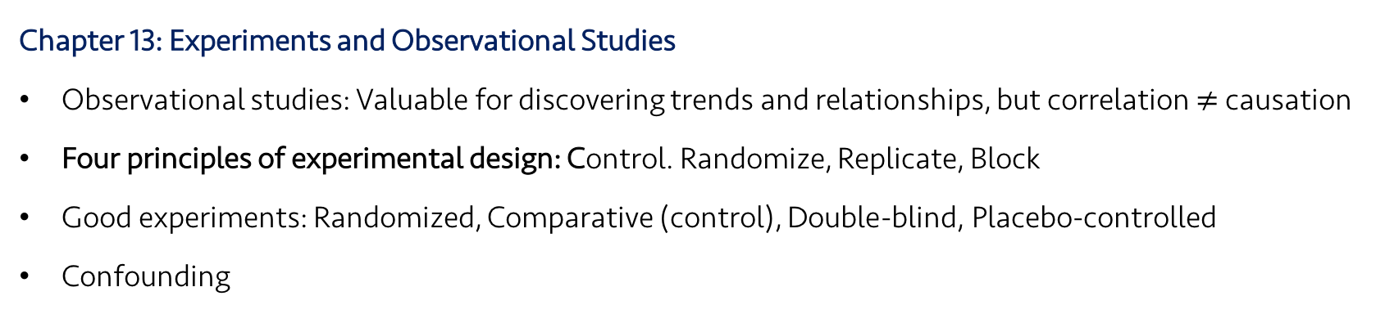
Lecture 08 | 100818
Key Points
Chapter 13: Experiments and Observational Studies
Observational studies: Valuable for discovering trends and relationships, but correlation $≠$ causation
Four principles of experimental design: Control. Randomize, Replicate, Block
Good experiments: Randomized, Comparative (control), Double-blind, Placebo-controlled
Confounding
CHOONG-WAN WOO | COCOAN lab | http://cocoanlab.github.io

Slide 16
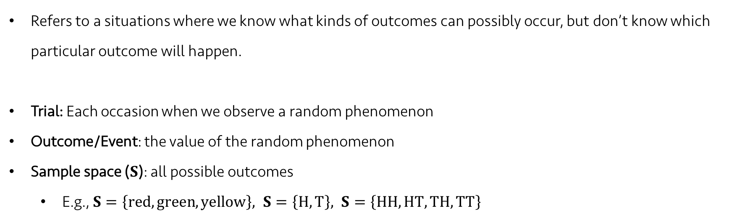
Lecture 08 | 100818
Random phenomena
Refers to a situations where we know what kinds of outcomes can possibly occur, but don’t know which particular outcome will happen.
Trial: Each occasion when we observe a random phenomenon
Outcome/Event: the value of the random phenomenon
Sample space ($S$): all possible outcomes
E.g., $S=\left\{red, green, yellow\right\}, S=\left\{H, T\right\}, S=\left\{HH, HT, TH, TT\right\}$
CHOONG-WAN WOO | COCOAN lab | http://cocoanlab.github.io

Slide 17
Lecture 08 | 100818
Law of Large Numbers (LLN)
When we repeat a random process over and over, the proportion of times that an event occurs settle down to one number, which is the probability of the event.
Two key assumption of LLN:
No changes of the random phenomena over the repeats
independence (all the events should be independent): an event doesn’t influence the outcomes of others.
This tells us nothing about “short-run” behavior. And the long run is really long.
Don’t expect the probability tells you a short-term trend of something.
CHOONG-WAN WOO | COCOAN lab | http://cocoanlab.github.io

Slide 18
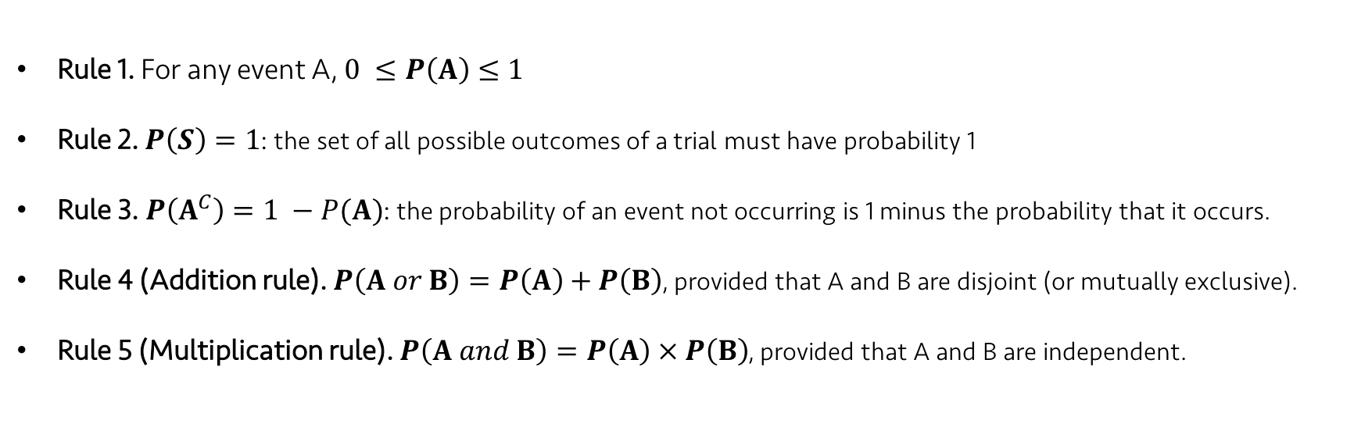
Lecture 08 | 100818
Rules of formal probability
Rule 1. For any event A, $0 ≤P\left(A\right)≤1$
Rule 2. $P\left(S\right)=1$: the set of all possible outcomes of a trial must have probability 1
Rule 3. $P\left(A^{C}\right)=1 −P(A)$: the probability of an event not occurring is 1 minus the probability that it occurs.
Rule 4 (Addition rule). $P\left(A or B\right)=P\left(A\right)+P\left(B\right)$, provided that A and B are disjoint (or mutually exclusive).
Rule 5 (Multiplication rule). $P\left(A and B\right)=P\left(A\right) × P\left(B\right)$, provided that A and B are independent.
CHOONG-WAN WOO | COCOAN lab | http://cocoanlab.github.io

Slide 19
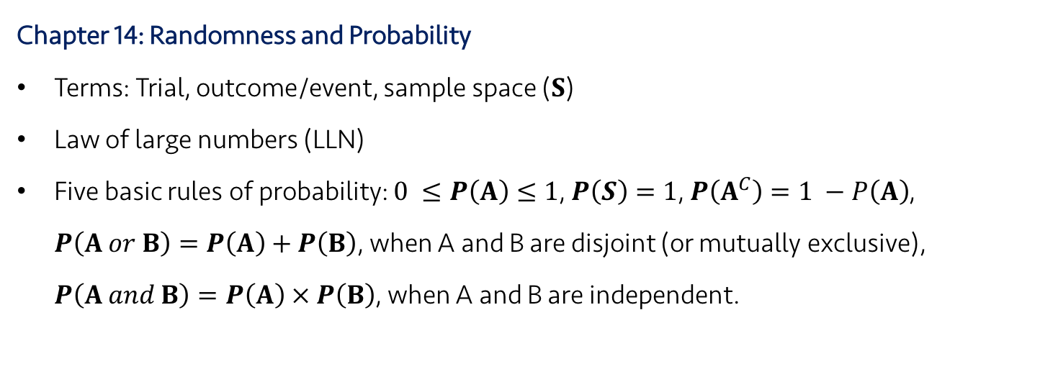
Lecture 08 | 100818
Key Points
Chapter 13: Experiments and Observational Studies
Observational studies: Valuable for discovering trends and relationships, but correlation $≠$ causation
Four principles of experimental design: Control. Randomize, Replicate, Block
Good experiments: Randomized, Comparative (control), Double-blind, Placebo-controlled
Confounding
Chapter 14: Randomness and Probability
Terms: Trial, outcome/event, sample space ($S$)
Law of large numbers (LLN)
Five basic rules of probability: $0 ≤P\left(A\right)≤1$, $P\left(S\right)=1$, $P\left(A^{C}\right)=1 −P\left(A\right)$, $P\left(A or B\right)=P\left(A\right)+P\left(B\right)$, when A and B are disjoint (or mutually exclusive), $P\left(A and B\right)=P\left(A\right) × P\left(B\right)$, when A and B are independent.
CHOONG-WAN WOO | COCOAN lab | http://cocoanlab.github.io

